Slide 1
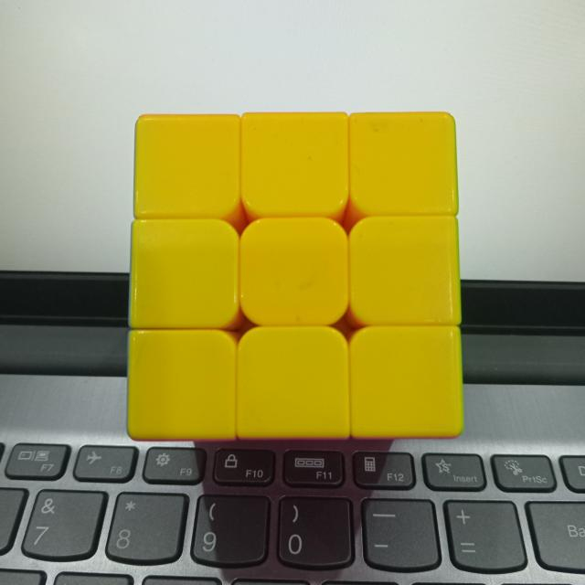

Slide 2
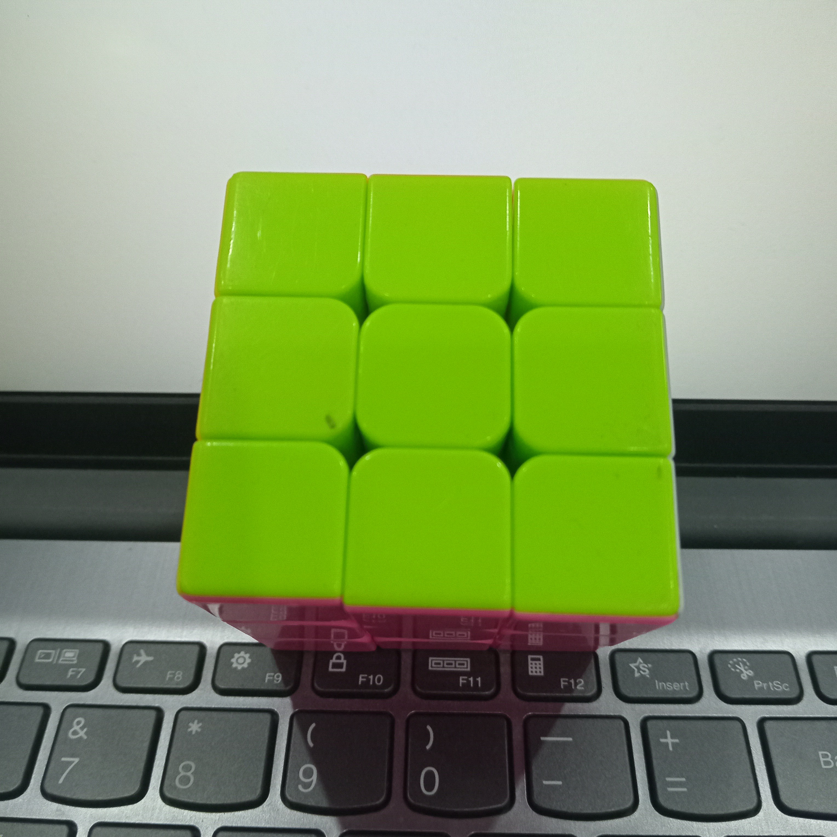

Slide 3
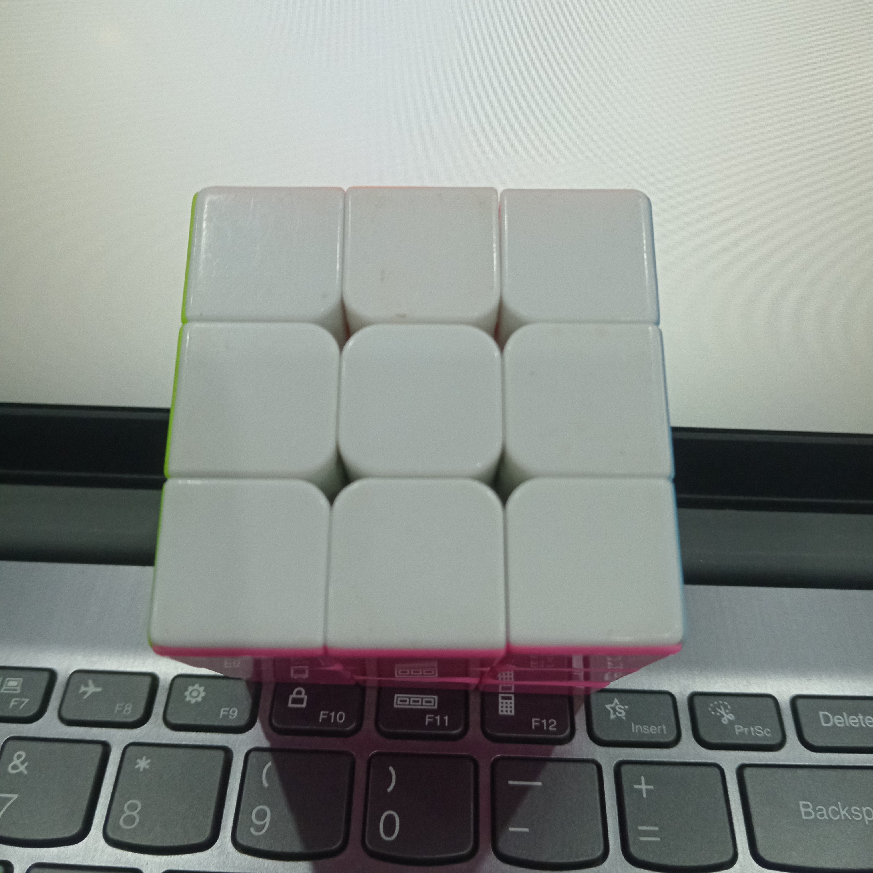

Slide 4
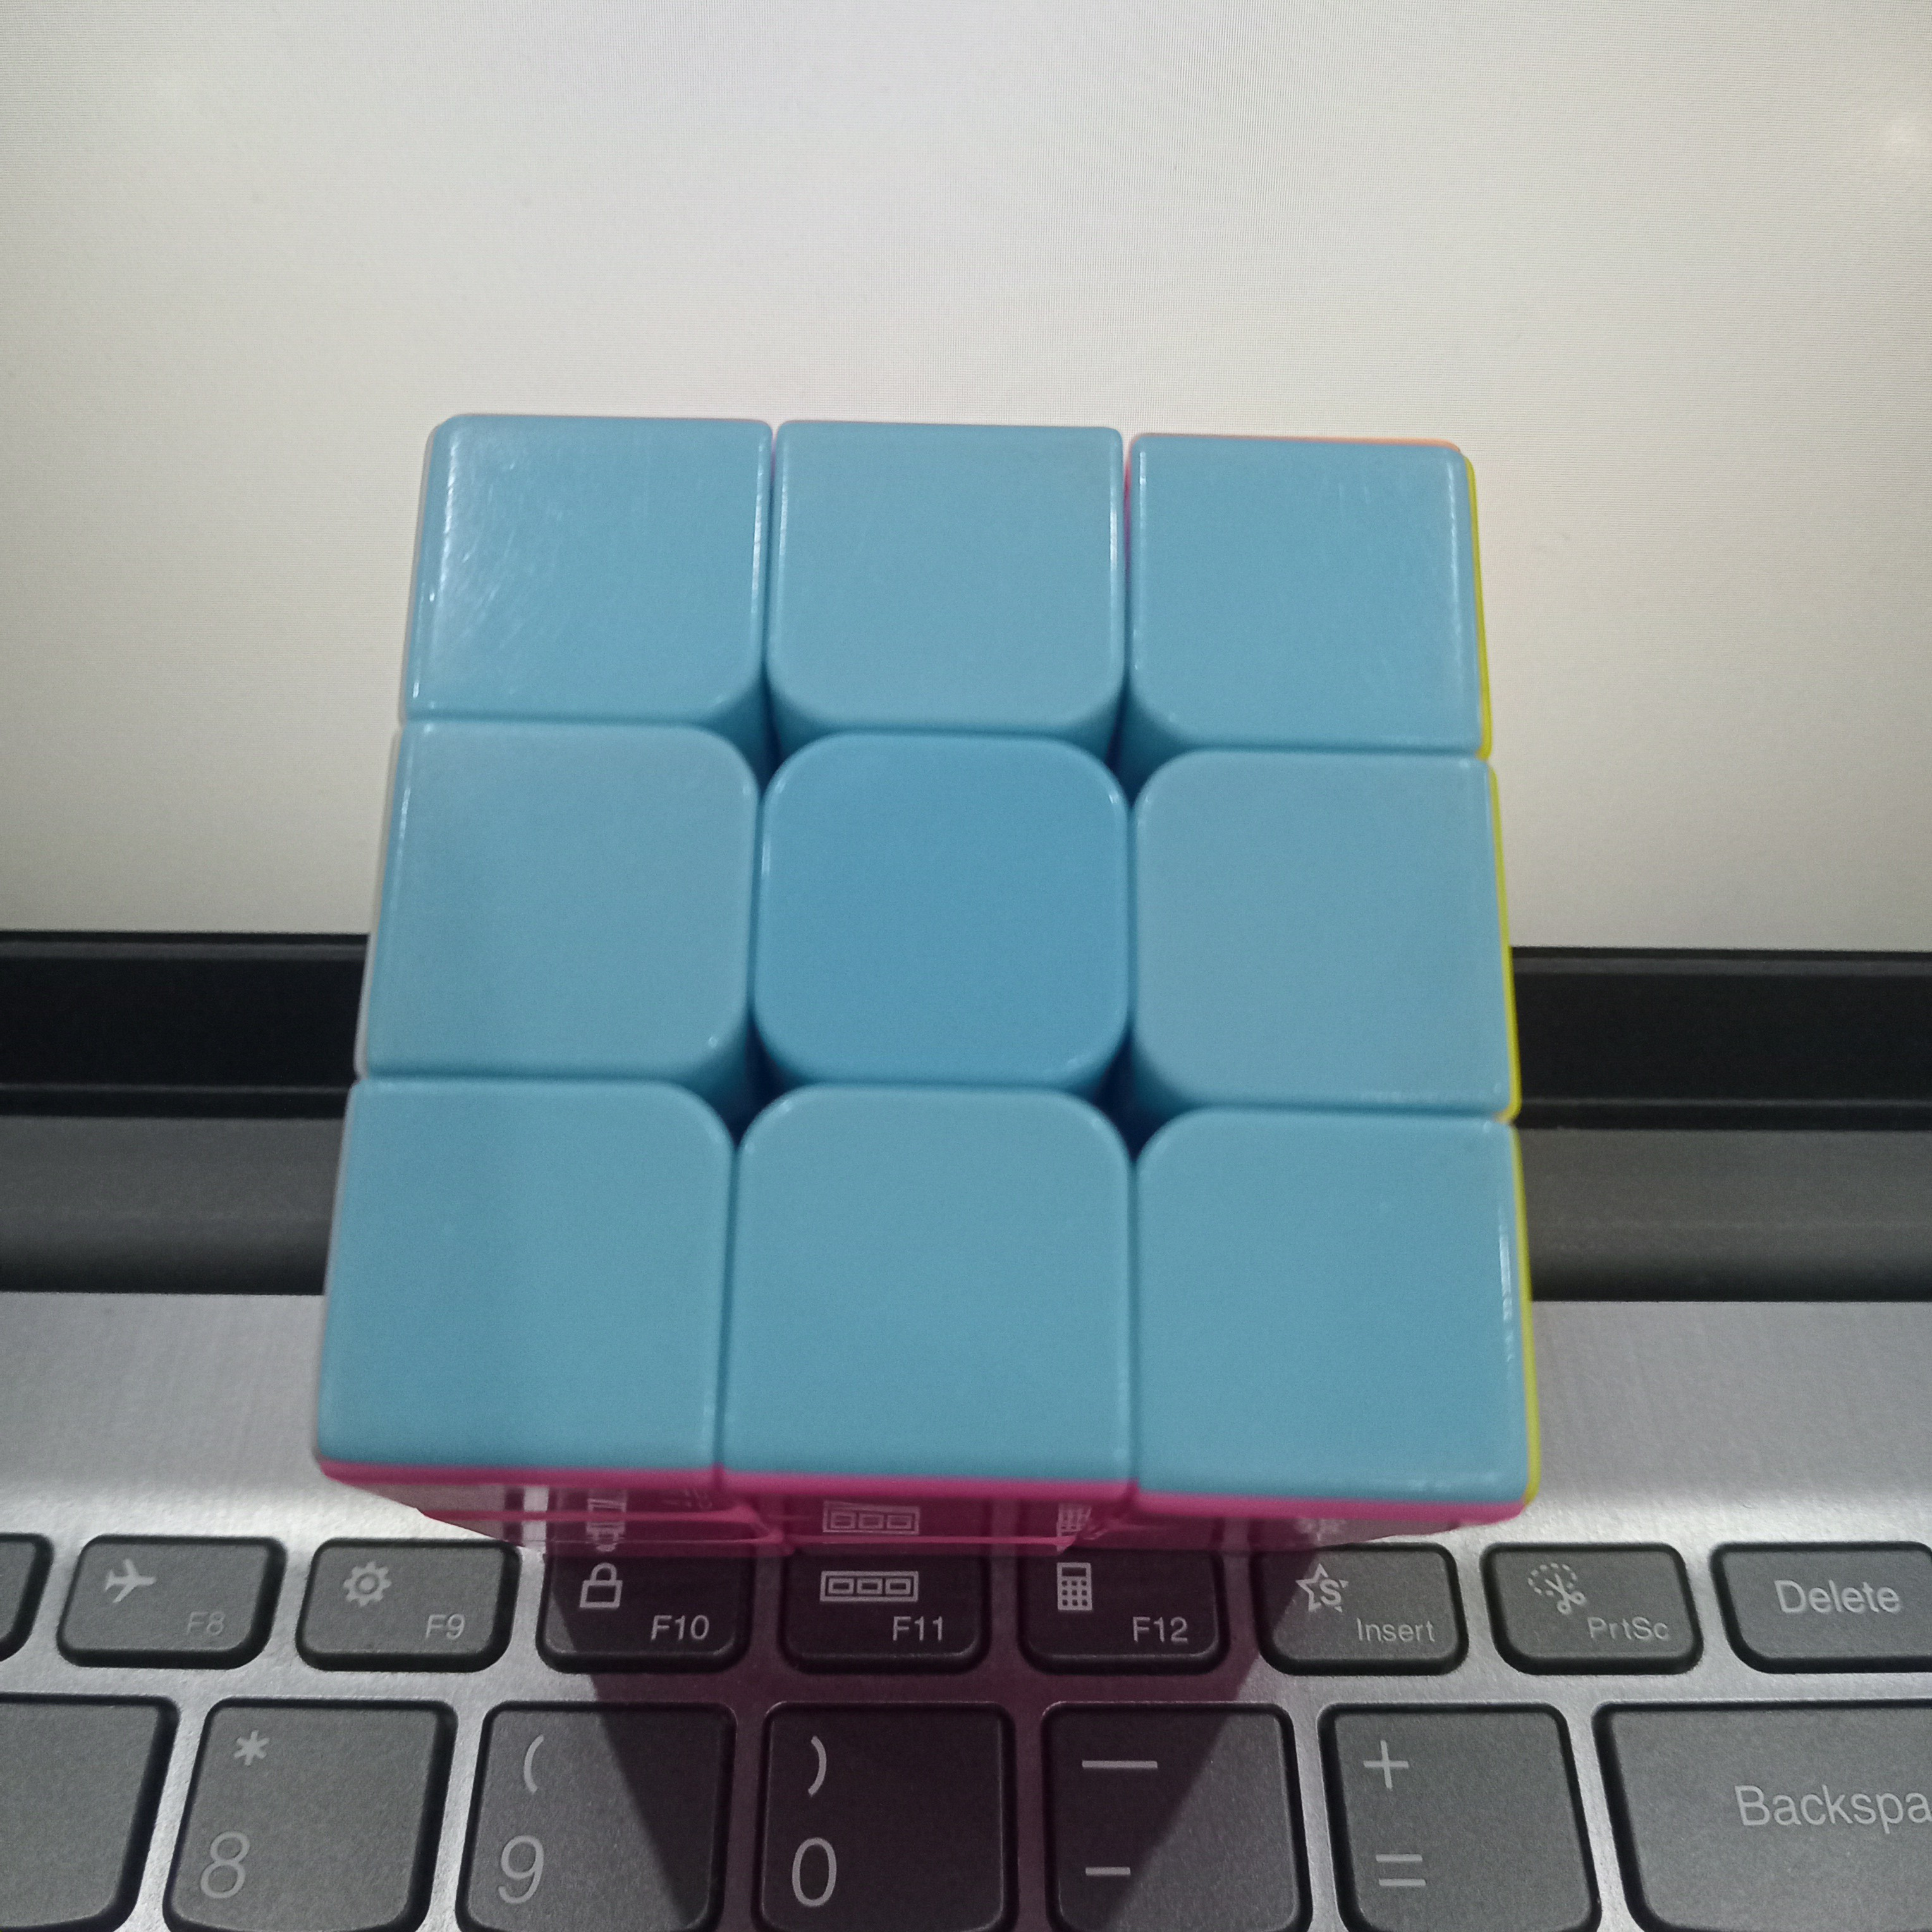

Slide 5
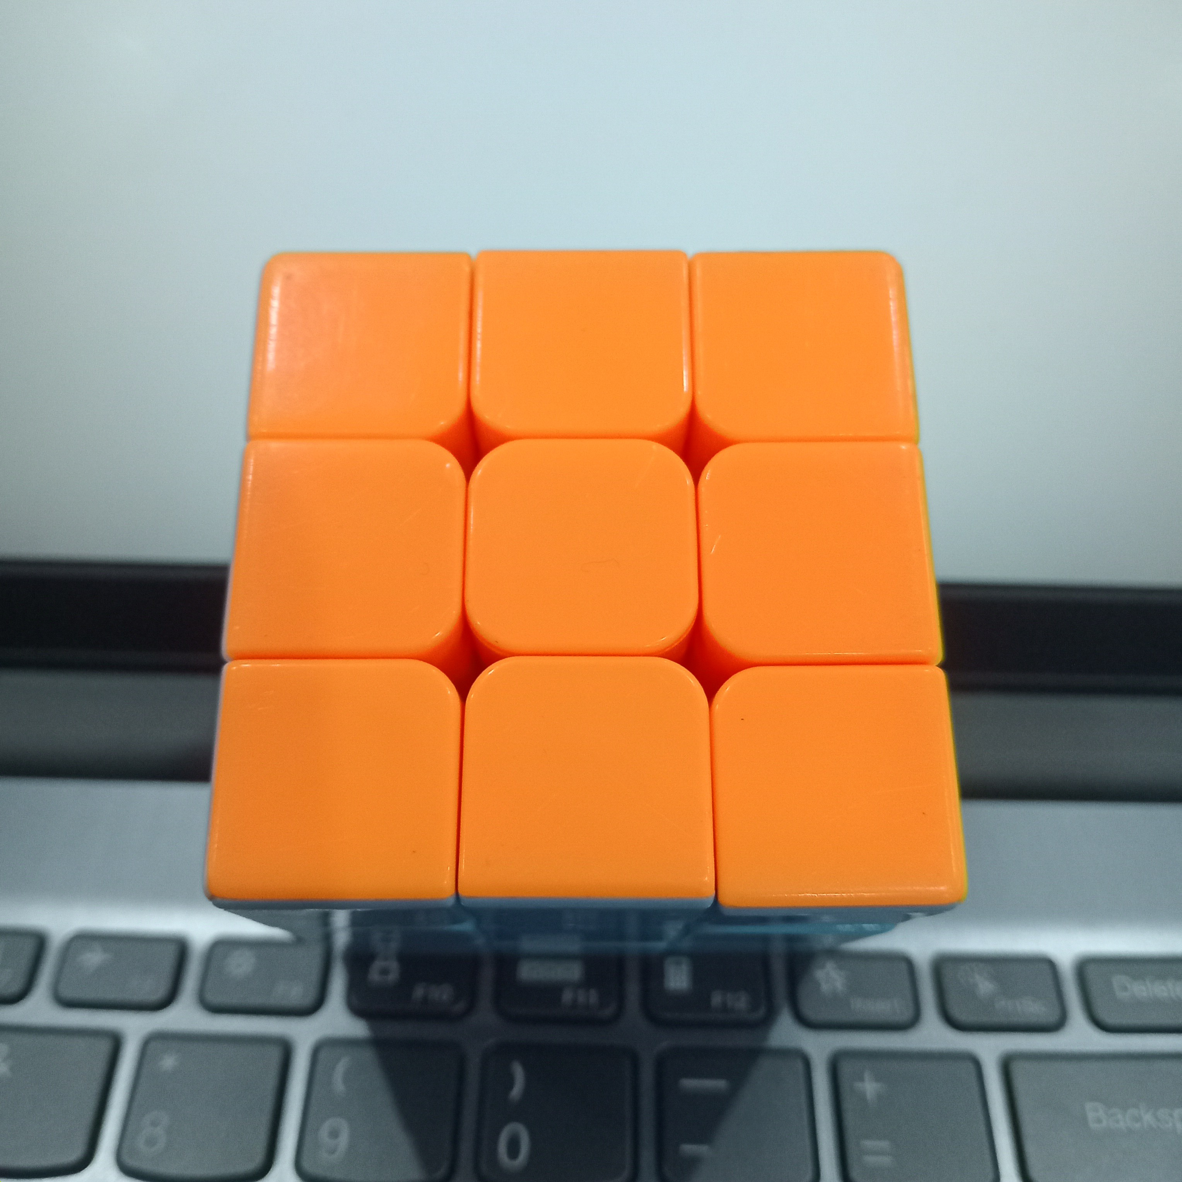

Slide 6
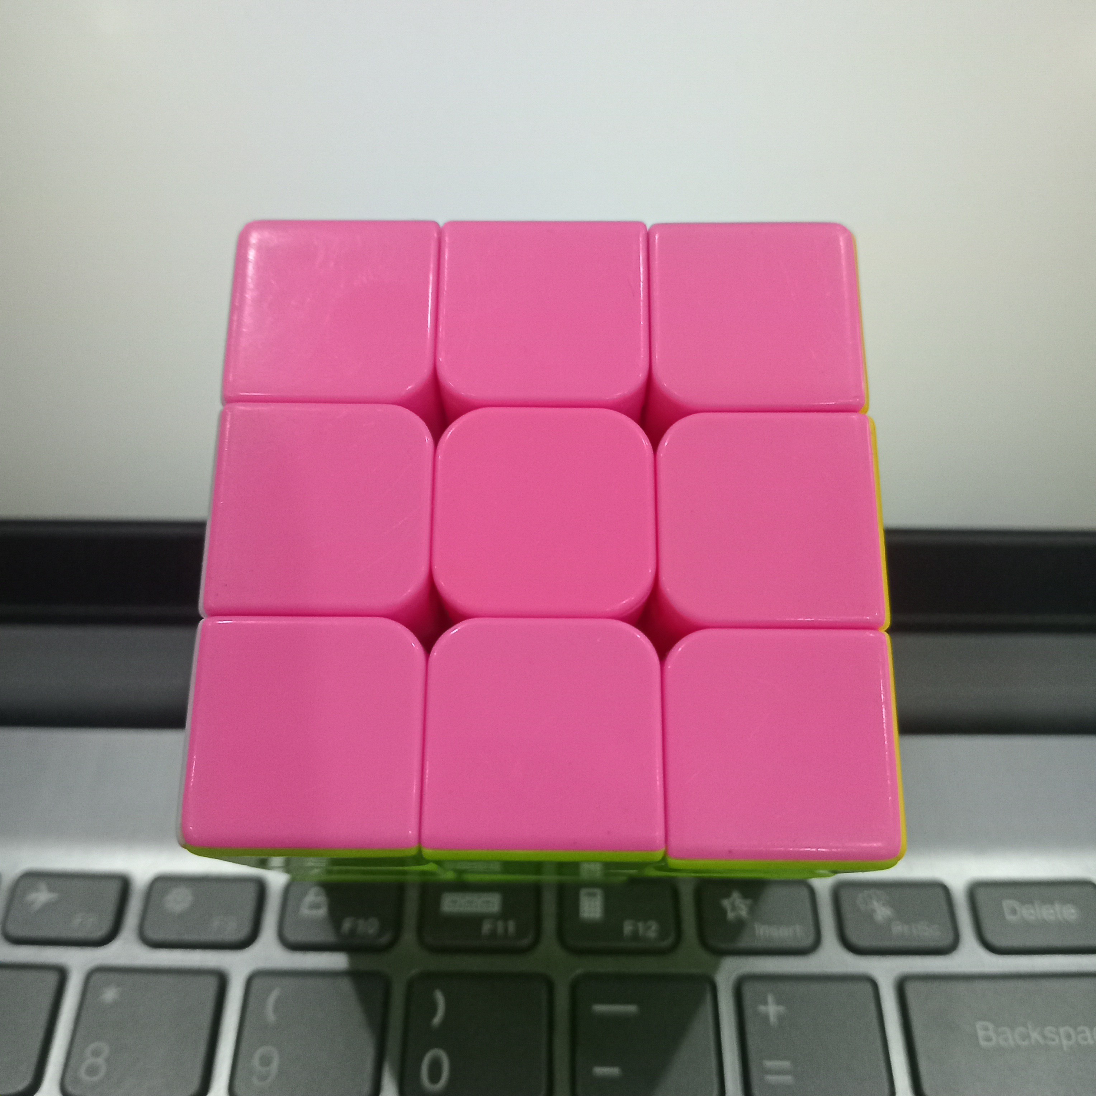

Slide 7
kuning: r = 208, g = 177, b = 1
h = 25.505, s = 253.776, v = 208.0035
h = 26, s = 254, v = 208
hijau: r = 125, g = 195, b = 1
h = 40.825, s = 253.6995, v = 194.9985
h = 41, s = 254, v = 195
putih: r = 172, g = 177, b = 173
h = 66, s = 7.191, v = 176.9955
h = 66, s = 7, v = 177
biru: r = 112, g = 164, b = 185
h = 98.63, s = 100.623, v = 185.0025
h = 99, s = 101, v = 185
oranye: r = 254, g = 145, b = 50
h = 13.97, s = 204.7905, v = 254.0055
h = 14, s = 205, v = 254
merah: r = 226, g = 103, b = 157
h = 166.83, s = 138.771, v = 226.0065
h = 167, s = 139, v = 226
U: h = 66, s = 7, v = 177
R: h = 167, s = 139, v = 226
F: h = 41, s = 254, v = 195
D: h = 26, s = 254, v = 208
L: h = 14, s = 205, v = 254
B: h = 99, s = 101, v = 185

